Slide 1

Leveraging Weather Events to Maximize Airline Stock Portfolio
Sam Lawhead
Jon Mitchell
Virginia Murage
Chandler Schaak

Slide 2
Executive Summary
As our climate changes, the airline industry is seeing more and more cancellations & delays
Airline success (i.e. generating profits) is very dependent on efficient operations
Our Hypothesis is that when airlines see significant disruptions at their main hubs, there should be a decrease in the stock price 1-3 days afterwards
If theory holds true, there is a market inefficiency that can be exploited with accurate weather modeling

Slide 3
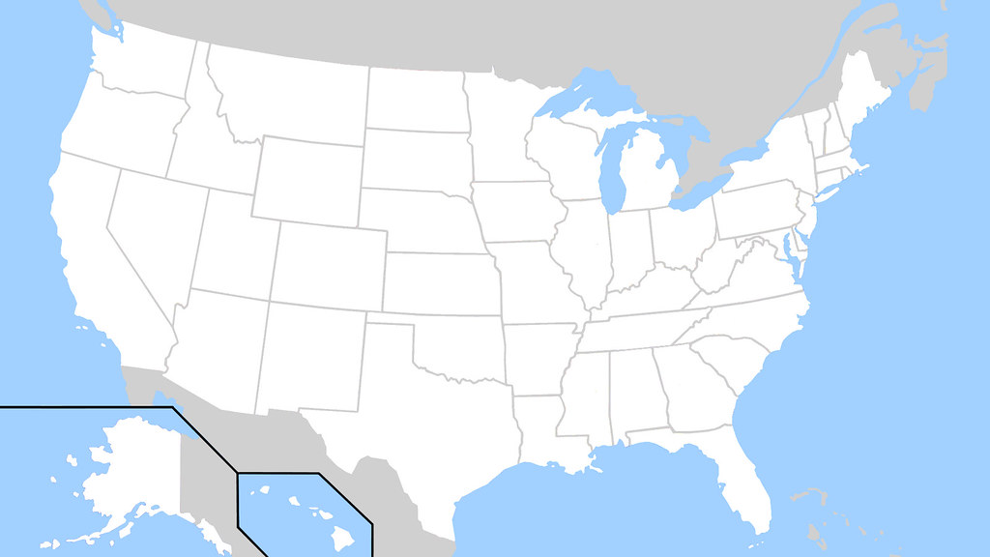




Airlines & Hubs
Focus on 4 Airlines
Delta Airlines (DAL) & Atlanta (ATL) hub
United Airlines (UAL) & Chicago (ORD) hub
American Airlines (AAL) & Dallas (DFW) hub
Alaska Airlines (ALK) & Seattle (SEA) hub

Slide 4
Metrics, Sources & Assumptions
Weather Data
Source: ()
Metrics Used: Daily precipitation, Windspeed & Visibility
Airline Performance Data
Source: (Bureau of Transportation Statistics
Metrics: Total daily flights into hub, % that are late, % cancelled
Stock Performance
Airline closing stock prices and daily percentage change
Timeframe
January 1, 2015 – December 31, 2019
5 Years of data provides 1,825 data points for airline performance
Excluded 2020 to present due to COVID and the impact on the industry

Slide 5
Baseline Stock Performance
5 Year Annual Rate of Return Holding Stock
DAL – 5.6%
AAL - (-11.2%)
UAL – 5.8%
ALK – 4.1%
Total Portfolio – 2.2%

Slide 6
Correlation Between Stock & Flight Cancellations
<Will add code snippets here>

Slide 7
Conclusions
No correlation between weather events and stock prices
Even managing the portfolio on the weather forecasts will just be gambling
We were excited / hopeful to find a correlation, but once again finding market inefficiencies are proving hard to find and / or capitalize on

